Slide 1


Exploring the Relationship Between User Ratings and Box Office Success
Katie Northrup

Slide 2
Why Analyze Movies This Way?
User ratings are not enough to understand a movie’s success.
Financial performance (budget, revenue) offers a deeper lens.
Goal: Combine user-generated data with financial metadata to explore what makes a movie popular and profitable.

Slide 3
Data Sources and Collection Strategy
MovieLens (ml-latest-small)
Ratings, tags, movie titles, genres
TMDb API
Budget, revenue, production companies
Challenges
TMDb API was slow and rate-limited
Some financial data missing or incomplete
Random sampling caused inconsistent results ➜ replaced with fixed set

Slide 4
From Raw CSVs to Clean SQL Tables
Extracted release years from titles using regex
Cleaned and standardized movie titles
Joined datasets via tmdbId
Financials pulled via Python + TMDb API, then cached
Result: Consistent, enriched dataset across 4+ tables

Slide 5
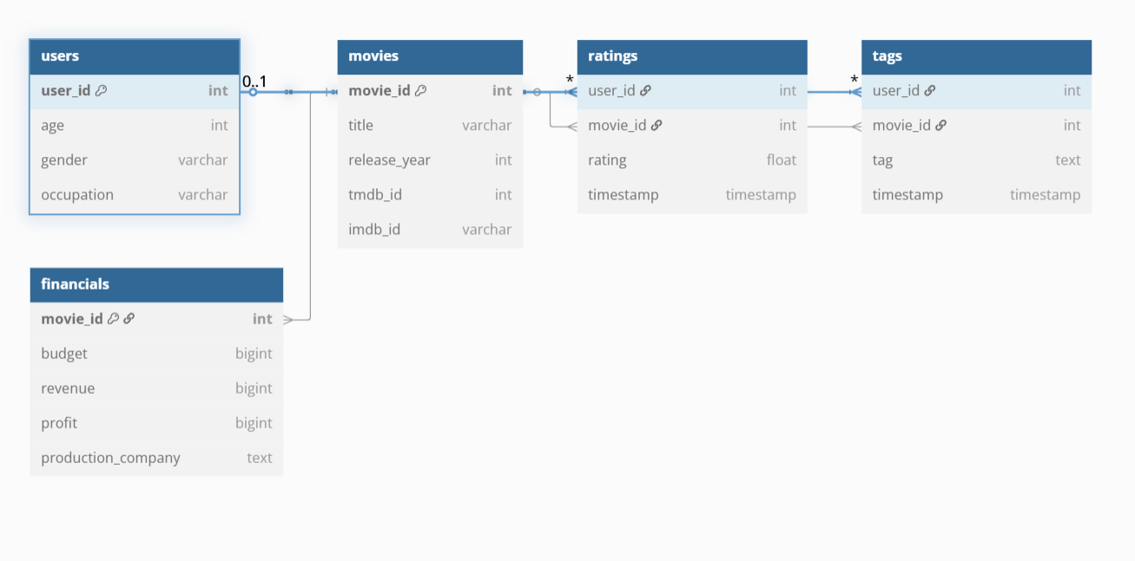
Relational Database Design

Slide 6
What the Data Revealed
Most profitable films differ from most liked
High revenue ≠ high ratings (audience taste ≠ box office)
Tags reveal viewer sentiment (e.g., “underrated”, “classic”)
Top production companies produced multiple successful films

Slide 7
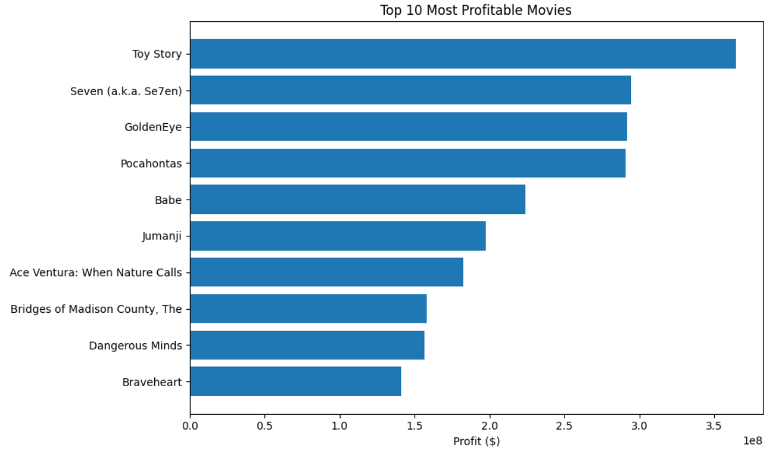

Slide 8
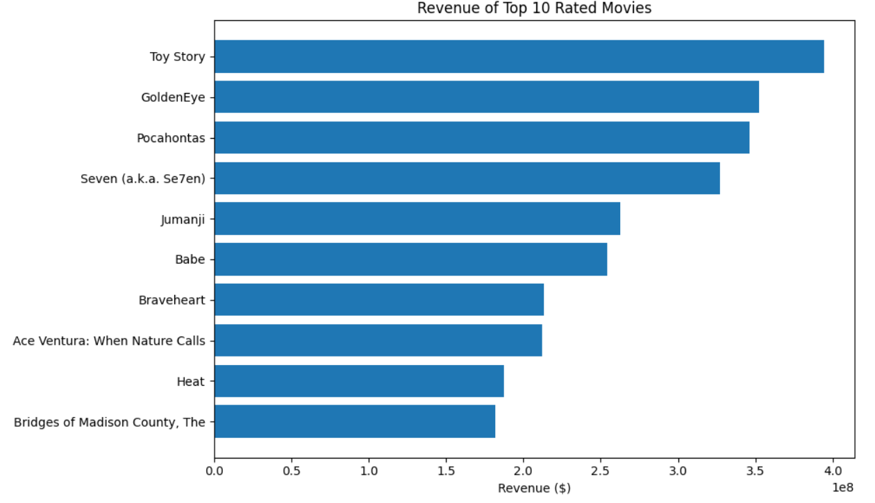

Slide 9
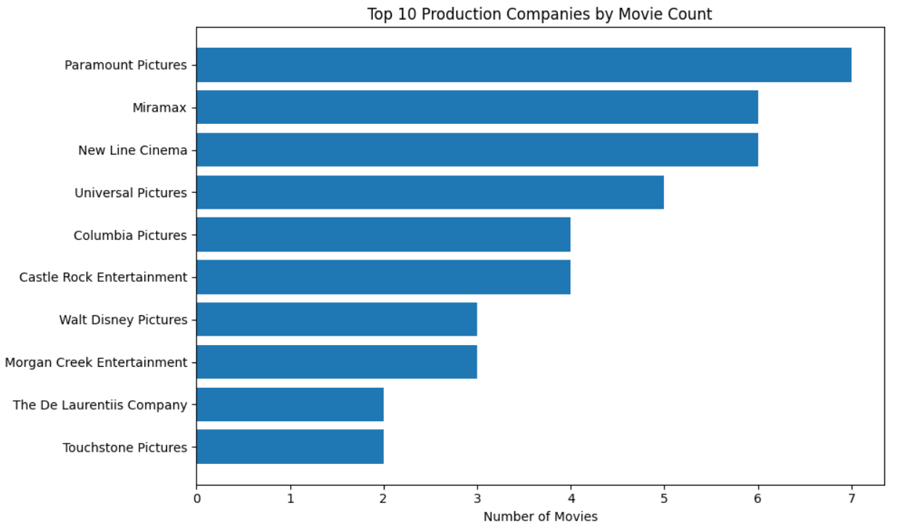

Slide 10
Conclusion
Integrated two open data sources into one structured SQL database
Enabled rich analysis through SQL + Python
Built reproducible pipeline from ingestion to visualization
Future work: Scale API fetch to 500+ movies, add genre/actor analysis

